Slide 1
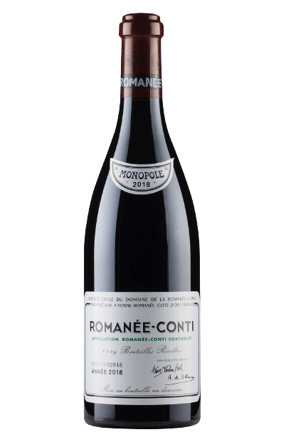


LGSI-2023 Smart Winery System
Doyong Kwon
Seohyun Park
Wonseok Han
Dohyeon Jeong
Jun Choi
Jaeyun Lim

Slide 2
Index
Introduction
Use cases
System Architecture
Preprocessed Data
System Demo
Android
WebOS
Further Improvements

Slide 3
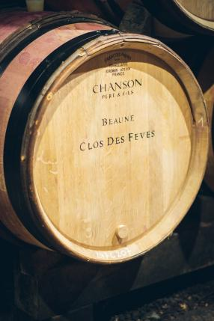

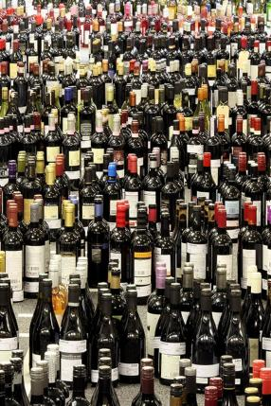
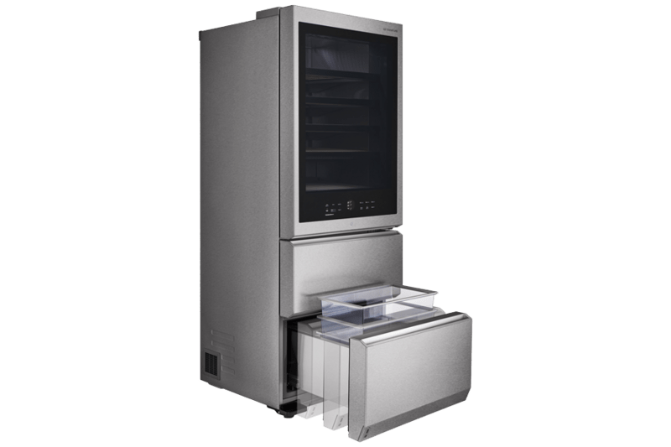
Introduction
Smart Winery System
WINE
Oak Barrel
Luxury
variety

Slide 4

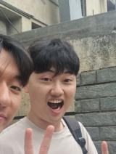

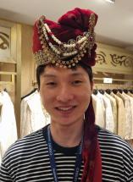


Introduction
Team Leader
WebOS
Wine Algorithm
AI Chat Bot
Data preprocess
Android
Crawling
Android
Doyong Kwon
Dohyeon Jeong
Wonseok Han
MongoDB
API
AWS Server
MongoDB
API
Wine Algorithm
Barcode generator
Figma
Android
Jaeyun Lim
Jun Choi
Seohyun Park

Slide 5

Main Feature
Algorithm
Calculate Average Temperature of Wines & Set Temperature of each floor
Search Optimal Location to Store Wine & Show Sequence of Setting Wine Cellar Status

Slide 6

Main Feature
AI Chat Bot
Recommend the Wine for User
Ex) It’s our anniversary, Can you recommend wine?
Get Wine & Pairing Information

Slide 7


Main Feature
Application
WebOS: Imbedded Wine Cellar Application
(Check and Control Cellar Status, Chat Bot)
Android: Mobile Wine Cellar Application
(Check and Control Cellar Status, Reserve Wine,
Insert New Wine)

Slide 8
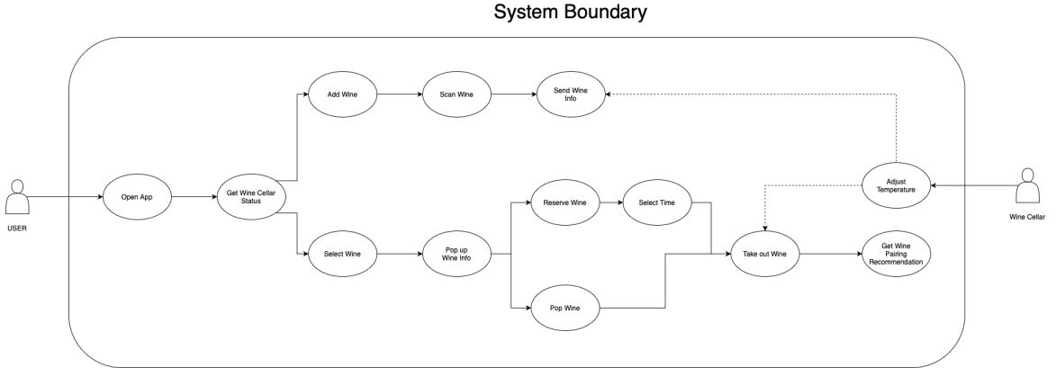
Use Case: Overall

Slide 9









System Architecture
OpenAI
Wine Cellar
Server
Android Application

Slide 10




Web Crawling
Wine21.com Website
Save as JSON file
Crawling using selenium and python

Slide 11
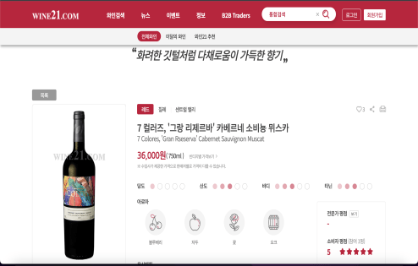
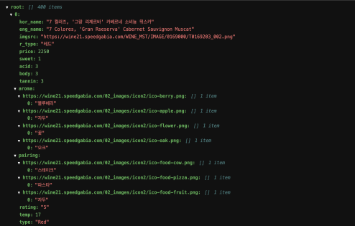
Web Crawling
Name, Image sources, Type, Price, Taste, Aroma, Pairing Information

Slide 12
Data Preprocessing
1. Merging JSON Files Containing Wine Information.
2. Convert Price Information from Won to Rupee.
3. Extract Aroma and Pairing Types.
4. Korean-English Translation
(Make python dictionary for translation and map to wine information)
5. Listing Image Sources for Image Output.
(For wine, aroma, pairing information)

Slide 13
Application Feature: Android

Slide 14



Slide 15
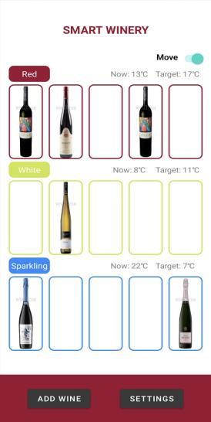
Switch(Move/Info)
Layer type information
Display current temperature
and Target temperature
Move to Barcode Scan Page
Move to Setting Page

Slide 16
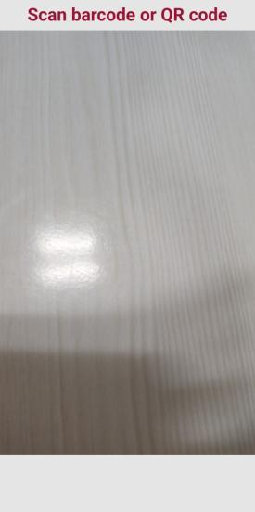

Scan wine barcode

Slide 17
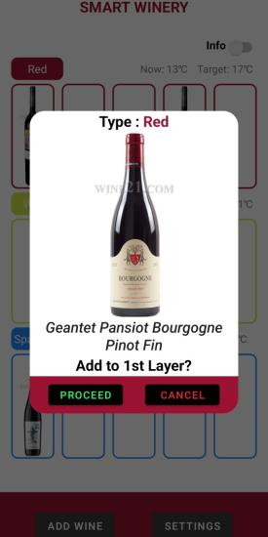
Wine type info(Red, White, Sparkling)
Display wine info(Image and name)
Indicate which layer to add

Slide 18
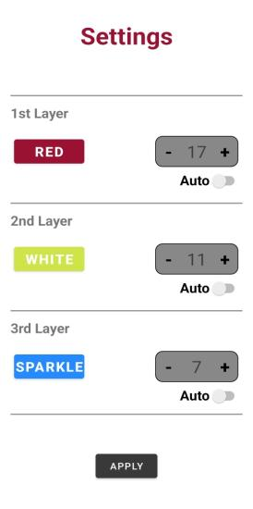
Wine type status of Layer(RED, WHITE, SPARKLE, USER)
Can change to other type only if the layer is empty
Mode change (Auto/User)
Adjust the temperature automatically in Auto mode

Slide 19
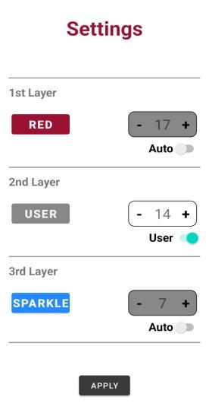
Adjust the temperature manually
Enabled in User mode
Disabled when there are mixed type of wine in the layer
When clicked, switches to the type of the wine present in the layer

Slide 20
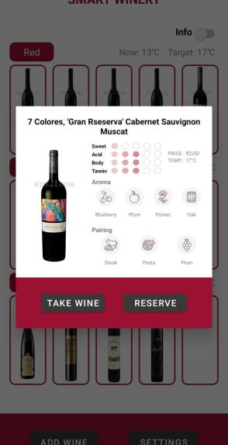
Name of wine
Profile of wine
Aroma and recommended pairing
Pops up a reservation dialog
Removes the wine from cellar

Slide 21
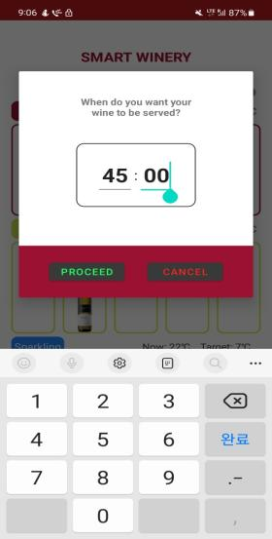
Set the timer to the desired time
Toast message when the wine is ready

Slide 22
Application Feature: WebOS

Slide 23
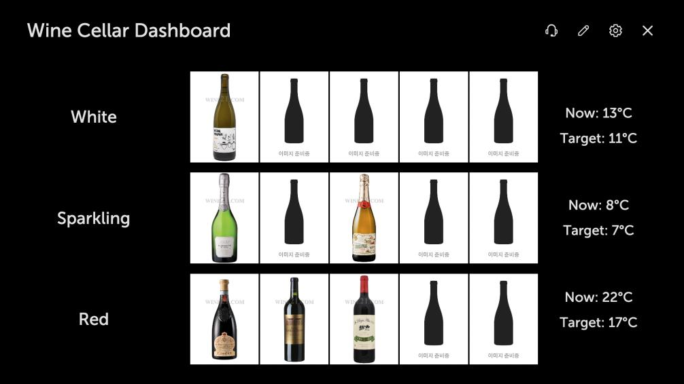
Feature Menu
Storage
Layer Type
Temperature

Slide 24
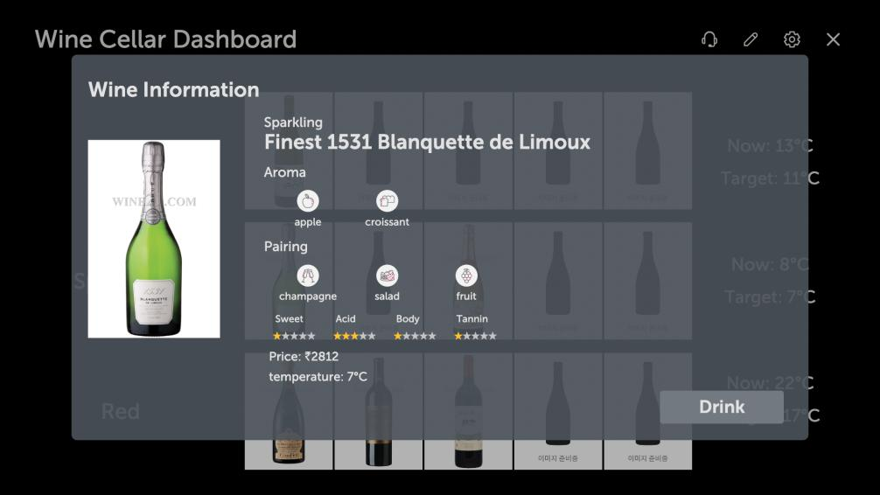
Delete Wine

Slide 25
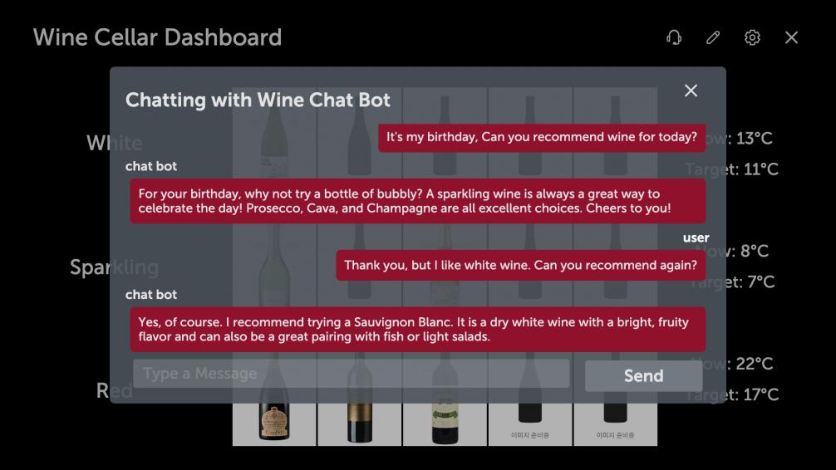
Send Message

Slide 26
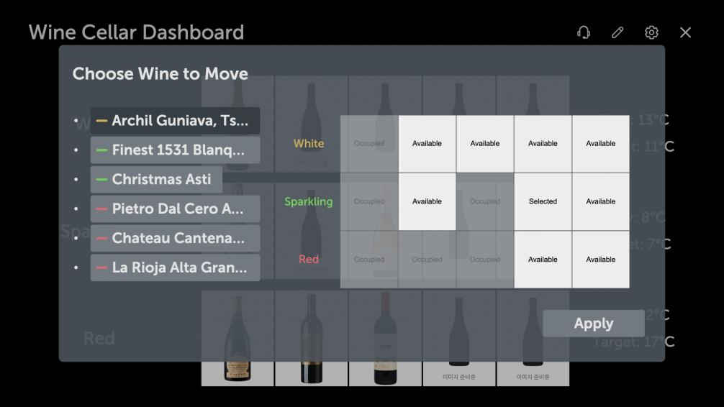
Choose Location
Choose Wine to Move
Apply Change

Slide 27
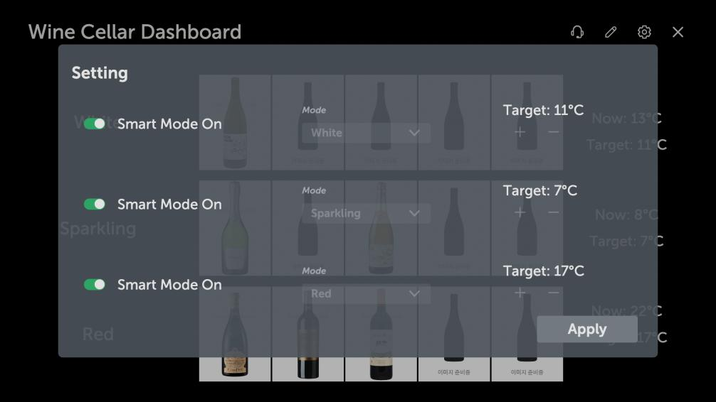
Choose Mode
Smart Mode On/Off
Change Temperature
Apply Change

Slide 28
Further Improvements
Implement TTS to communicate with GPT
Check remaining foods in refrigerator and Suggest pairings
Use Fine-tunning model instead of 3.5 turbo

Slide 29
Q&A

Slide 30
Thank You for Listening

